Slide 1
Analysis of World Happiness Data 2019

Slide 2
Data Context
The World Happiness Report is a survey of the state of global happiness. Which was first published in 2012, the second in 2013, the third in 2015, and the fourth in the 2016. The World Happiness ,which ranks countries by their happiness levels. These reports gained global recognition as governments, organizations and civil society increasingly use happiness indicators to inform their policy-making decisions. Various experts and organizations used these reports to analyze how measurements of well-being can be used effectively to assess the progress of nations.

Slide 3
Source of data and data description
We will use the 2019 csv file. This data has been taken from https://www.kaggle.com/unsdsn/world-happiness.
Kagggle is an open source platform and datasets available on Kaggle are public datasets.
This data has 9 columns and 156 observations.
Score and Overall rank are the dependent variable while rest are independent variables.

Slide 4
Objective-
We wish to address some very common questions regarding happiness of countries in the World through this data. We are also trying to understand factors which are used to calculate happiness score and in what extent these factors are contributing to predict the happiness score. We would like to address following questions by our analysis. We will compare countries based on happiness score, GDP per capita, healthy life expectancy ,corruption perception and freedom to make life decisions.

Slide 5
Research questions-
What are the countries rank the highest in overall happiness and how many factors contributing to happiness score?
How does country ranks or happiness scores change from previous years to 2019 report?
Which country has the highest per capita income?
What countries have most trusted Government and least trusted Government based on the corruption?

Slide 6
Continued..
Which country has high healthy life expectancy and which has least?
What are countries ranked best and worst in terms of freedom of life decisions?
Which factors have strongest and least association with happiness score?
How much these factors are contributing to predict happiness score?

Slide 7
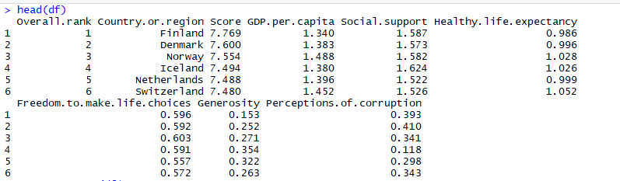
Exploratory data analysis
Below is the glimpse of the dataset which will be useful to understand the structure of data.

Slide 8
Continued..
There are six factors GDP per capita ,social support, healthy life expectancy
,freedom of life choices, generosity, perceptions of corruption.
So from previous slide we observed that Finland has been ranked first with 7.769 happiness score where as South Sudan has been ranked last in the survey with 2.853 happiness score.
Finland has been chosen the happiest country from 2018 and Denmark also kept it’s place secure again as second happiest country in the world.

Slide 9
Continued..
Qatar has the highest GDP per capita in the world. Where as Somalia which is ranked as 112 out of 156 countries has 0 GDP per capita.
Singapore ranked as 34 with happiness score 6.262 has the perception of most corrupt government and Moldova ranked as 71with happiness score 5.529 has most trusted government.
Singapore has highest healthy life expectancy where as Swaziland has the least healthy life expectancy and It is ranked as 134.

Slide 10
Continued..
Uzbekistan ranked as 41 has highest freedom in terms of life decisions where as Afghanistan ranked as 154 has lowest freedom for making life decisions.
Average happiness score is 5.407,median is 5.380 ,standard deviation is 1.11 and range is (2.853,7.769).
To find association We will calculate correlation between happiness score and rest of variables. Correlation between happiness score and GDP per capita is 0.793 highest. which indicates strong positive association between these two variables. Generosity is least correlated to happiness score with correlation 0.075.We will try few more ways to address our last question in more depth.

Slide 11
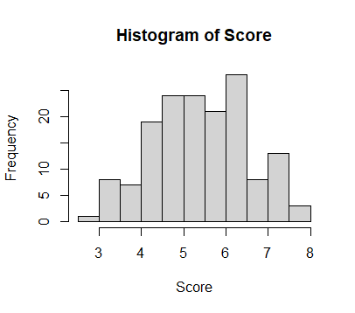
Visualization of data
We are interested in understanding happiness score , other factors and their relationship in more depth and visualizing them can disclose various insights. We will plot histogram of happiness score to understand the distribution and pair plot can also be a good choice to reveal the trend between the pair factors in the data.
In the above plotted histogram of happiness score we observed that it seems symmetric but not sharp peaked. This information will be helpful to propose suitable model for happiness score.Next we will look at pair plot.

Slide 12
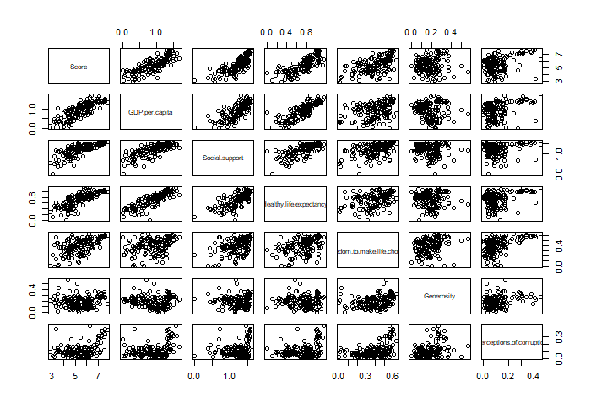
Pair plot between pair of factors in the data

Slide 13
Continued..
Since we are interested in understanding the relationship between happiness score and rest factors. We plotted the pair plot to get a rough idea.
It seems all factors were showing increasing trend with happiness score but GDP per capita , social support, healthy life expectancy ,freedom to make life choices and perception to corruption are factors which were showing linear increasing trend with happiness score.
It does not seem surprising that Generosity was not showing any obvious pattern with happiness score. Since we already knew that correlation between these two was very less.

Slide 14
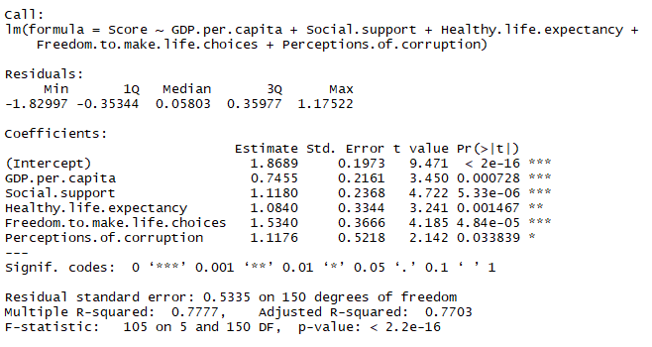
Model Fitting
We propose to fit a multiple regression model to predict the happiness score since these factors seem to have linear relationship with happiness score.
Above is the summary output from R for our proposed model. Most of factors seem significant except perception of corruption. And the adjusted R-squared was 0.77. Which indicates that our model were able to capture the 77% variability of happiness score.

Slide 15
Comparison with literature-
In the literature various types of models have been suggested to understand relationship to model happiness score using other factors but we only focused on linear model which seemed reasonable model based on our previous findings.
There have been various type of data visualization work suggested to analyze all these factor in more detailed way. But we only used certain plots which seemed to help us in to finding possible answers to questions we stated earlier.
Discussion:-
There are scope of adding various aspect to analyze this data in more detailed manner such as exploring relationship between other variables, comparing various proposed models and in what extent they contribute in explaining each other’s variability.
If we can add some other factors in this data such as literacy rate , gender ratio and population size then we can enhance our ability to answer most of the question we explored.

Slide 16
References
A Data Analysis of the World Happiness Index and its Relation to the North-South Divide (Undergraduate Economic Review). (2019, December). Research Gate. Retrieved April 16, 2022, from https://www.researchgate.net/publication/337720530_A_Data_Analysis_of_the_World_Happiness_Index_and_its_Relation_to_the_North-South_Divide_Undergraduate_Economic_Review
Leona Ann Manoj. (2020, August 3). RPubs - World Happiness Report 2020. R Pubs. https://rpubs.com/LeonaAnn/645318
Wikipedia contributors. (2022, April 15). World Happiness Report. Wikipedia. https://en.wikipedia.org/wiki/World_Happiness_Report

